Slide 1
Pressure Ulcer Risk Primary Or Secondary Evaluation Tool - PURPOSE T
Version 2
Tissue Viability Service – May 2025
Copyright of the PURPOSE-T (Pressure Ulcer Risk Primary Or Secondary Evaluation Tool) and the associated user manual will remain with the CTRU, University of Leeds and the Leeds Teaching Hospitals NHS Trust.

Slide 2
Index
Overview of PURPOSE-T
Rationale for transition to PURPOSE-T
Assessment process and completion guidance
Selecting the appropriate care plan
Clinical cases and PURPOSE-T implementation

Slide 3
PURPOSE-T
Pressure ulcer risk assessment framework intended to identify adults at risk of pressure ulcer.
Makes a difference between:
  Primary Prevention (individuals at risk of pressure ulcer)
  Secondary Prevention (individuals with pressure ulcer/s).
Uses colours – rather than a score – to describe risk.
  Blue – No pressure ulcer/Not at risk
  Yellow/Orange – No pressure ulcer/ At risk
  Pink – Pressure ulcer category 1 or above/ scarring from previous pressure ulcer
Incorporated 3 phases:
  Screening
  Full assessment
  Assessment decision

Slide 4
PURPOSE-T
In comparison with existing risk assessment tools, Purpose-T:
  Involves a screening stage allowing rapid identification of those at potential/actual risk, while setting a date for reassessment:
    Saving time in practice
  Supports care planning in response to the patient’s risk profile rather than a condensed score
  Incorporated skin assessment/PU status and pain
  Clearly distinguishes between primary and secondary prevention
  Evidence-based (Fletcher, 2023)
  Currently recommended as best practice by the NWCSP (2023).

Slide 5
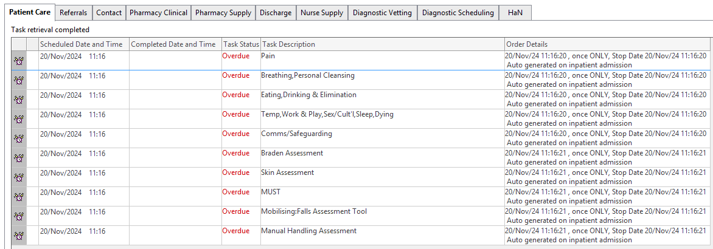
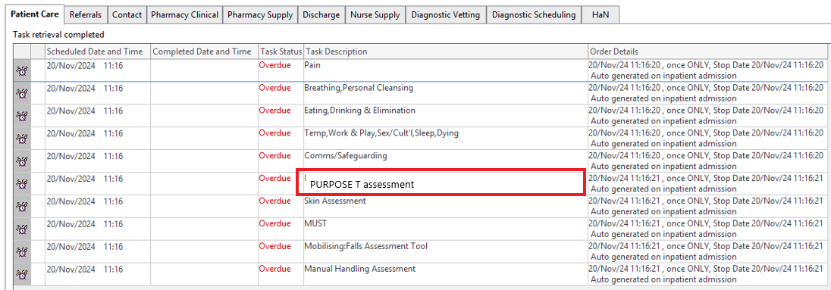
PURPOSE-T assessment
Task will replace the current Braden Assessment

Slide 6
When to complete?
The Task will trigger at patient admission
  The Step 1: Screening to be completed as soon as possible after admission/internal transfer
  If full assessment required, should be completed within 6 hours of admission.
Purpose-T needs to be re-assessed weekly or if there is any significant change in patient’s condition (same as how Braden Scale currently is implemented)
Purpose-T can be completed by RNs and RNAs.

Slide 7
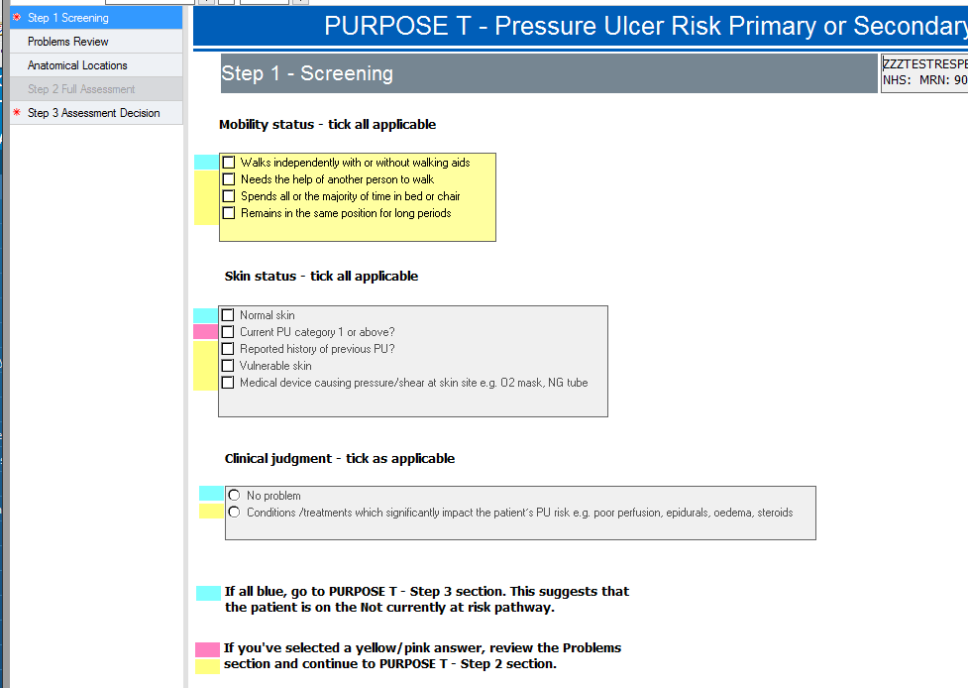
Step 1: Screening
To be completed for every adult inpatient
Allows a quick assessment. If no risk identified, no further assessment required.
Compromises of:
  Mobility
  Skin Status
  Clinical Judgment
(Purpose T User Manual V2, 2014)
Notes:
Step 1 Screening:
The purpose of the screening stage is to quickly identify those patients who are clearly not at risk and those with potential or actual pressure ulcers and require full assessment (Step 2).
If a yellow category is selected at this stage, the clinicians do not need to complete the remaining of the screening. Instead, they should proceed straight to the assessment stage (Fletcher, 2023).
Clinical judgment is required at this stage to differentiate between normal skin, vulnerable skin, those with medical device in place and those with an existing PU. For the assessment of “normal” or “vulnerable” skin, the clinician needs knowledge about common skin states – such as dry, paper-thin or moist – as well as a range of medications – such as steroids – plus common skin conditions, such as eczema (Stephen-Haynes and Maries, 2024).
Clinicians also need to consider how patients differ between day and night – example: patient that mobilise independently during the day but stay in the same position all night – and not immediately rule out any yellow boxes without proper evaluation (Fletcher, 2023).

Slide 8
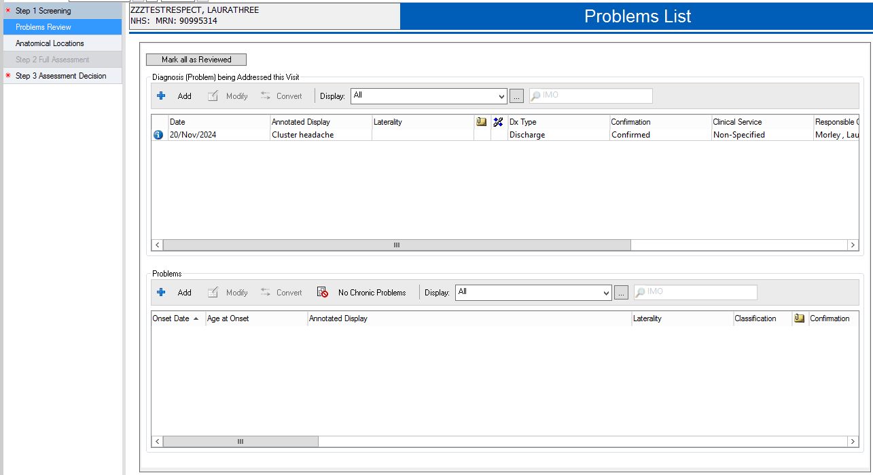
PURPOSE-T assessment (PowerForm)
Problems Review – displays Problems recorded

Slide 9
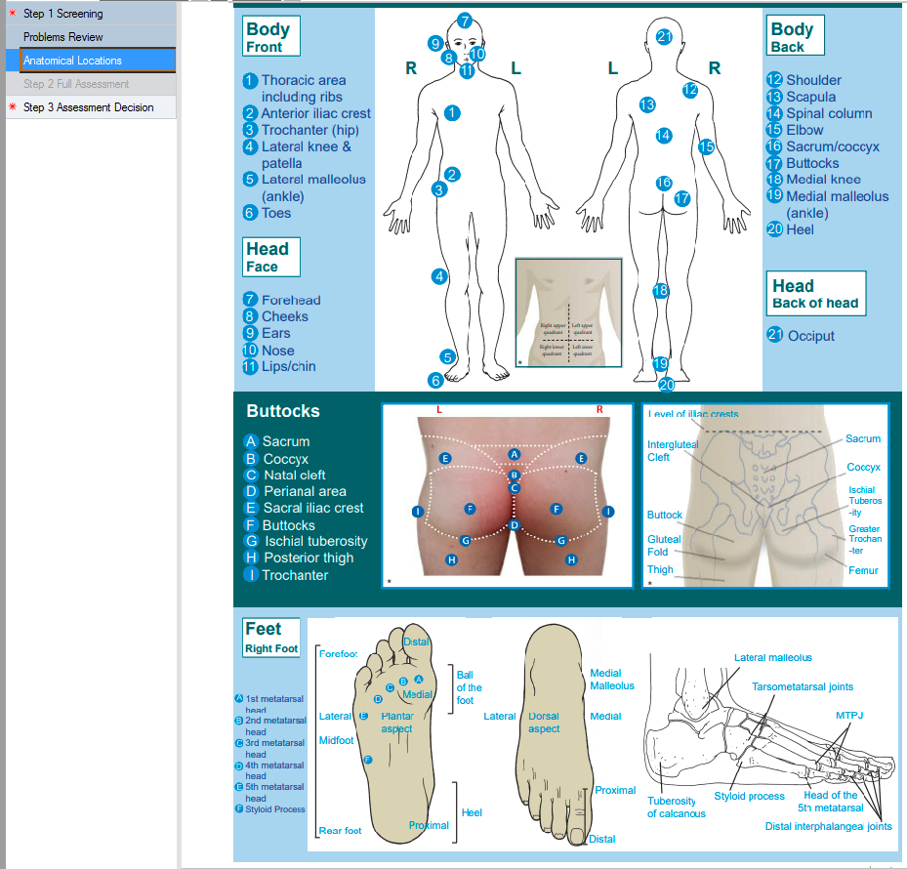
PURPOSE-T assessment (PowerForm)
Anatomical locations - for clarity and consistency of body locations

Slide 10
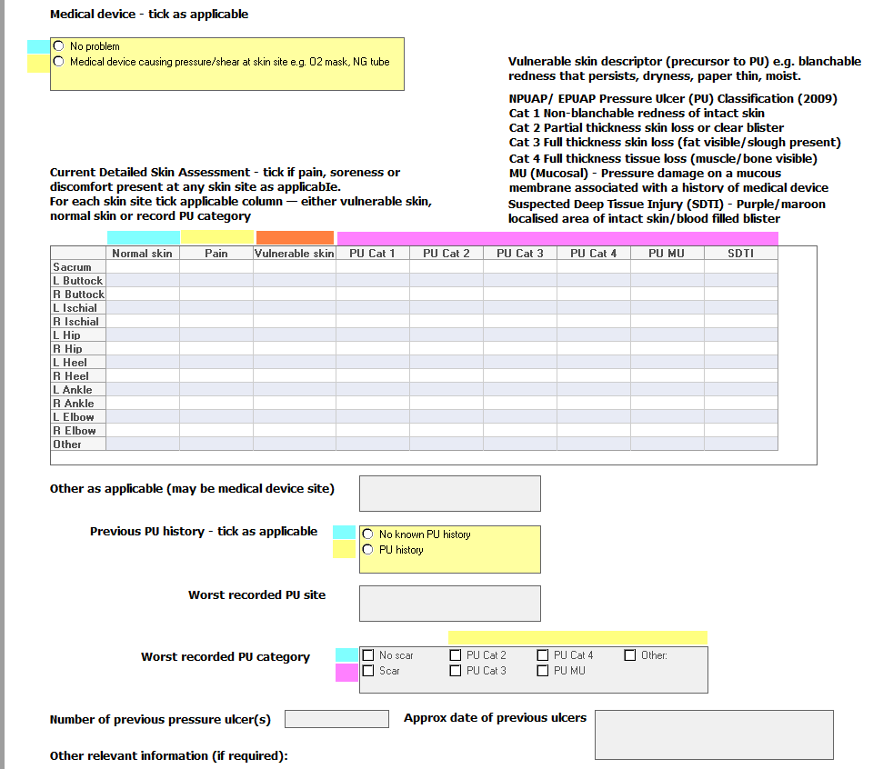
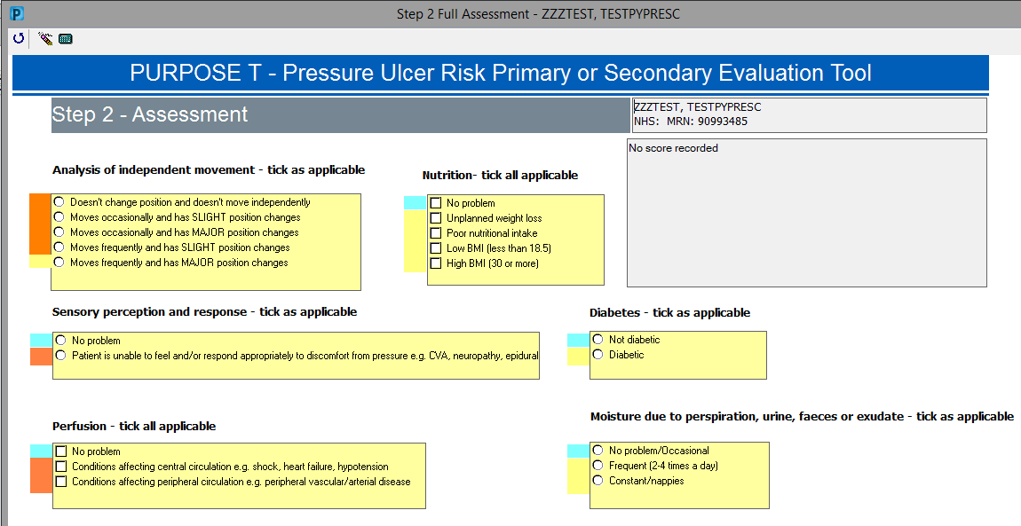
PURPOSE-T assessment (PowerForm)
Step 2 Full Assessment – triggered if indicated following Screening (Yellow/pink boxes ticked)
Notes:
Both Yellow and orange colours reflect risk – however orange represents a higher risk of pressure ulcer development

Slide 11
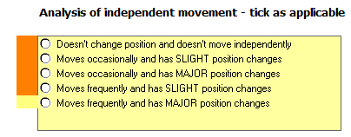
Step 2: Full assessment
Analysis of independent movement:
  Related to the movement that is undertaken
  by the patient without the assistance of another
  person.
  Frequency of position changes:
    Clinical judgement should be used to determine
    the appropriate category for the patient
  Extent of independent movement:
    Slight position changes - Shifting position a little in bed/chair but movement doesn’t completely offer pressure relief
    Major position changes – includes turning over in bed or standing up, resulting in a completely pressure relief.
(Purpose T User Manual V2, 2014)

Slide 12

Step 2: Full assessment
Sensory Perception and Response:
  Consider the ability to feel and/or
  respond appropriately to discomfort from pressure.
  Consider if patient has involuntary movements,
  Spams or spasticity/contractures.
  Factors that may influence an appropriate response to discomfort include:
    Compromise underlying medical condition (MS, CVA, Head Injury, Spinal Cord Injury, Neuropathy, Dementia…)
    Medical treatments (Epidural, anaesthesia, opiates).
(Purpose T User Manual V2, 2014)

Slide 13
Step 2: Full assessment
Full skin assessment must be done before completion of Purpose-T:
  If the patient declines, record refusal in EPR notes.
  Document by exception only.

Slide 14
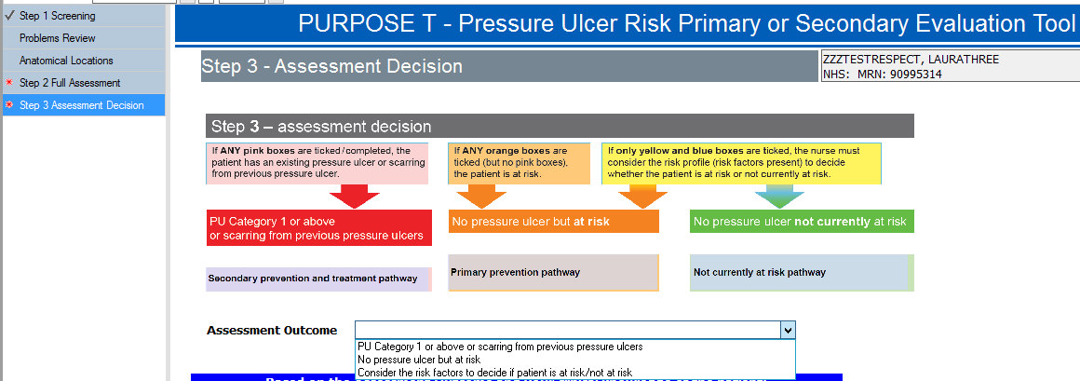
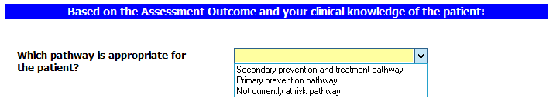
PURPOSE-T assessment decision (PowerForm)
Step 3 Assessment Decision – outcome based on responses (but also subjective to clinical decision)
The Assessment Outcome will be automatically populated based on the responses given in the Screening and Full Assessment sections
Based on the assessment outcome and your clinical judgement – you should choose what pathway the patient should be on
Notes:
Scoring is based on colours, not number score as previous Braden.

Slide 15
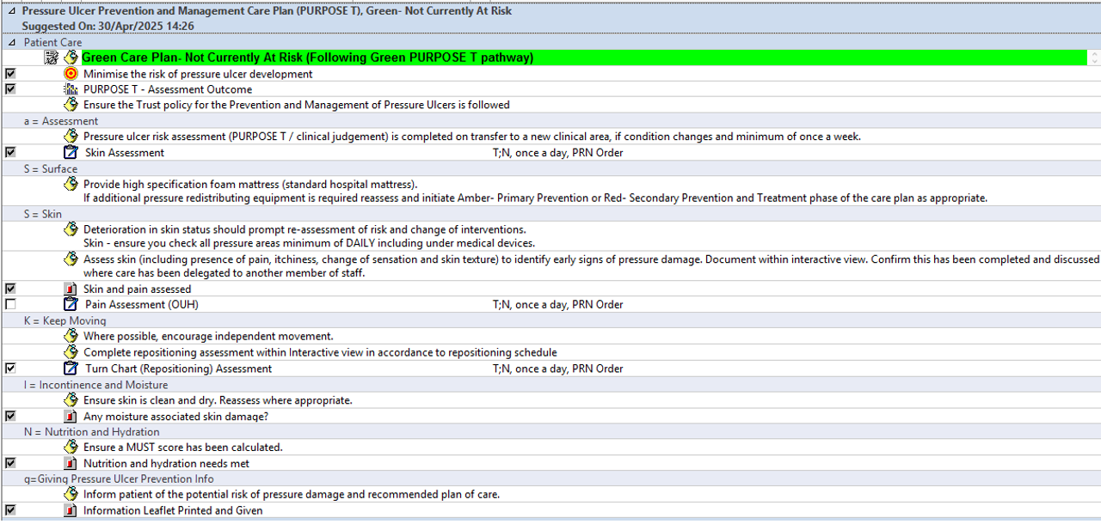
PURPOSE-T Care Plans

Slide 16
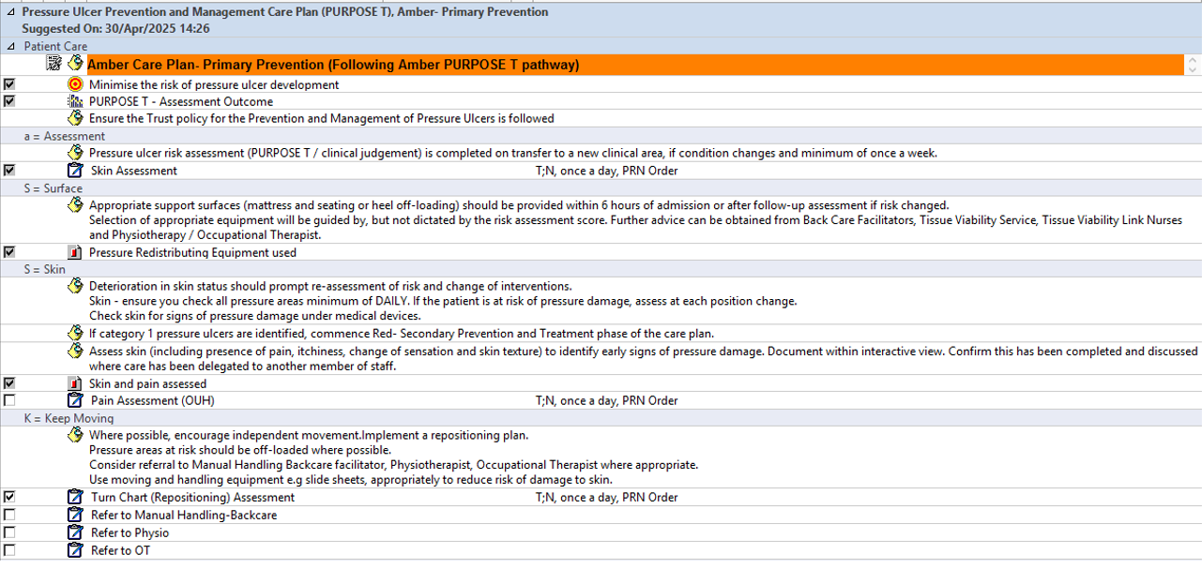
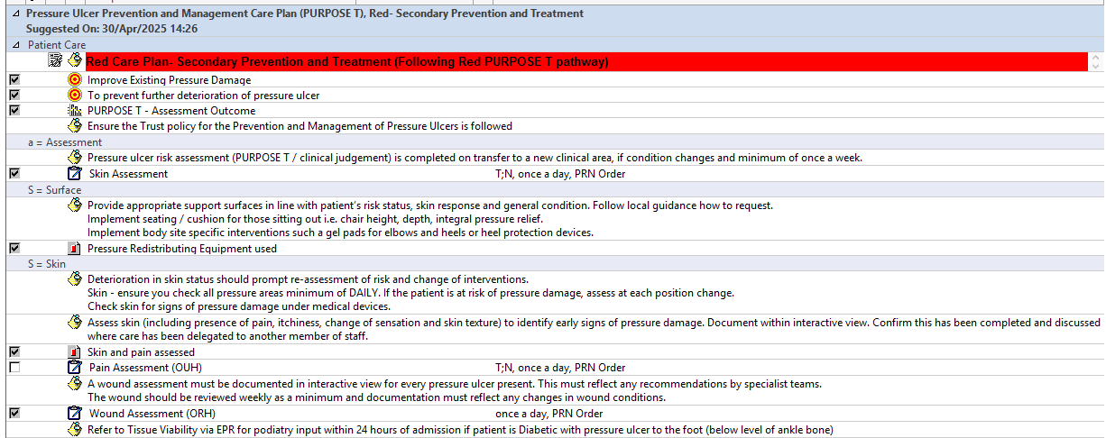
PURPOSE-T Care Plans
The care plans can be fully reviewed on the Step-by-Step guide available on TV Sharepoint site

Slide 17
Planning Care
Care plan should:
  Address the patient’s risk profile (factors)
  Consider patient preferences & ability to self-care
  Patients should be involved in decisions about their care
Essential Elements of Care include: aSSKINg Framework
  a: Assess risk each on admission and at least weekly thereafter or if condition changes
  S: Skin assessment – each shift actively check
  S: Support surface provision – are they on the right mattress/ heels off-loaded
  K: Keep moving/reposition/when in bed or chair
  I: Incontinence and moisture management.
  N: Nutrition – optimise
  g: Give information and include patient/carer in decision making/negotiation of care

Slide 18
Purpose-T Limitations
Scale initially developed on paper not integrated on electronic systems during development phase
  Purpose-T integrated to EPR by OUH Digital Team
No designated space for documentation of refusal from patient:
  Recommended to document on Nursing Notes if this occurs, as we document by exception.

Slide 19
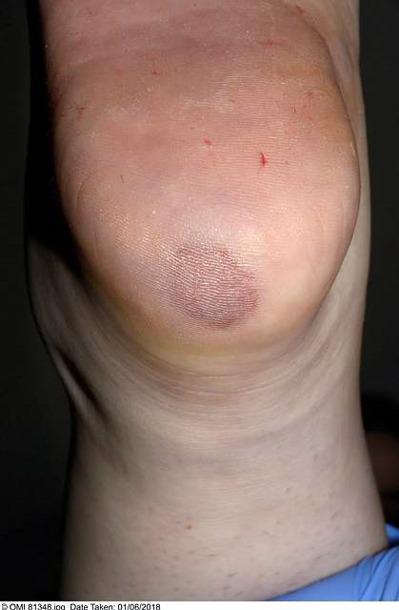
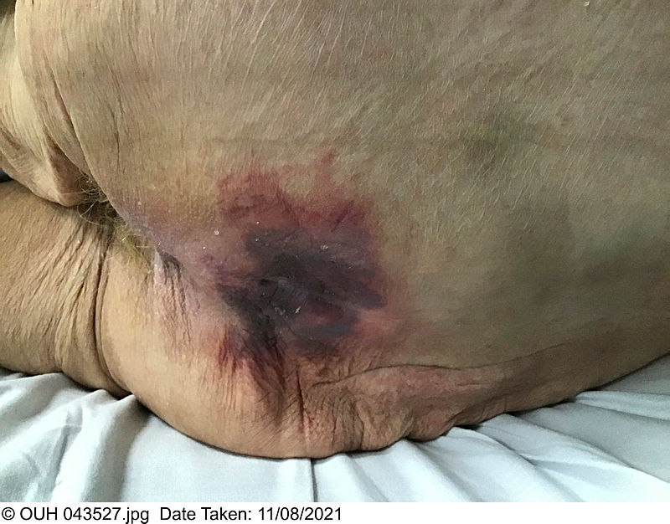
Clinical Cases – Example 1
Skin assessment:
Joan Smith, a 72-year-old lady who lives alone, has just been admitted to an acute medical ward following a stroke. Joan works part-time as a florist.
She was found unconscious on the floor by her friend. It is unclear how long she had been on the floor, but no one had seen her for 18 hours.
Prior to having the stroke Joan’s son reported she was in reasonable health and was fully mobile, though she does have hypertension which is controlled with medication. He reported that she had a good appetite, was not diabetic and didn’t have any problems with her circulation.
On admission Joan is conscious but dazed and had been incontinent of urine. She has a right sided hemiplegia and is unable to walk or weight bear.
Joan is presently being nursed in bed and a physio assessment is being undertaken later today. She is unable to change her position in bed. Joan is to be ‘nil by mouth’ until she has a swallow test, was dehydrated on admission and so has an IVI is in place. She is overweight.
Fig 1: Left heel
Fig 2: Sacrum
🔹 Please use the PURPOSE-T v2.0 – OUH document as guidance when completing the risk assessments.

Slide 20
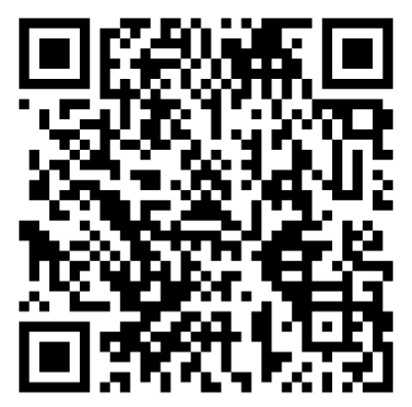
Clinical Cases – Further examples
Further case examples can be assessed via MLH.
PURPOSE-T presentation V1.0 –
OUH is available at MLH.
My Learning Hub – Purpose-T Introductory training
* To be added after Educational Leads feedback

Slide 21


Slide 22
References
Stephen-Haynes, J. and Maries, M. (2024) ‘PURPOSE-T: validity, reliability and implementation’, British Journal of Nursing, 33(4 Suppl), pp. S32–S38. Available at: https://doi.org/10.12968/bjon.2024.0105
Fletcher, J. (2023) Use of PURPOSE-T in practice: an evidence-based pressure ulcer risk assessment tool, Wounds UK, 19 (1). Available at: https://wounds-uk.com/wp-content/uploads/2023/05/WUK19-1_DHG-PurposeT.pdf
National Wound Care Strategy Programme (2023) Pressure Ulcer Recommendations and Clinical Pathway. Available at: https://www.nationalwoundcarestrategy.net/wp-content/uploads/2023/11/NWCSP-PU-Clinical-Recommendations-and-pathway-final-24.10.23.pdf
University of Leeds and Leeds Teaching Hospitals NHS Trust (2014). Pressure Ulcer Risk Primary Or Secondary Evaluation (PURPOSE T) Version 2 User Manual

